Slide 1
Medicare Inpatient 2017 Data analysis

Slide 2
Introduction
The medicare inpatient data is downloaded from cms.gov.in official website.
The dataset has two sheets one is medicare inpatient 2017 and another one is providers.
The data analysed using mysql and Microsoft excel and dashboard prepared in MS Excel.

Slide 3
Data Cleaning
The data was checked for null values and no null values were found.
The Provider id is the joining column for both the sheets therefore they are used for joining the dataset.
The DRG (Diagnosis Related group) ID and DRG definition are separated into two columns.
The columns average covered charges, average total payment

Slide 4
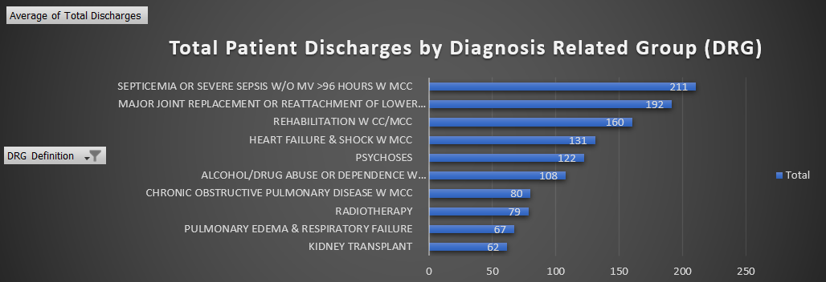
The Septicaemia has the more discharge which shows it is better curable and kidney transplant has the least due to various complication in transplantation procedures and post transplantation effects. However readmission data should be considered before making any conclusion about the higher discharge rate.

Slide 5
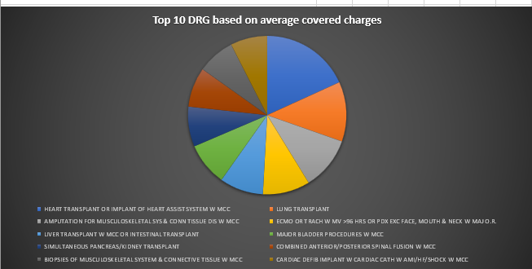
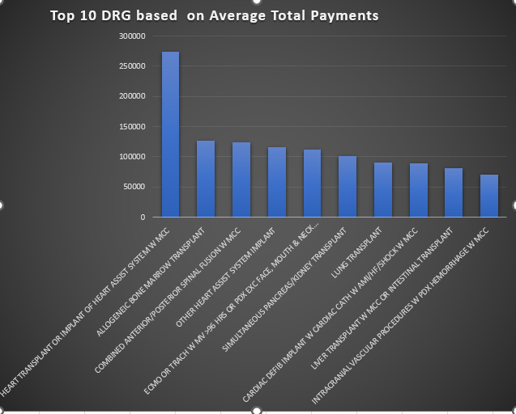
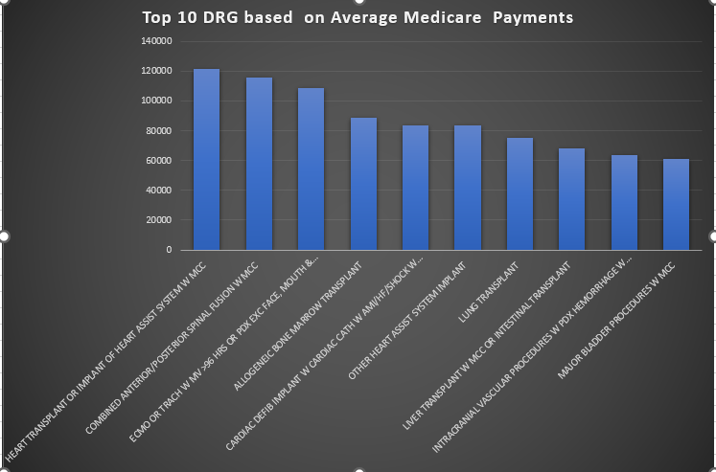
The heart transplant is overall most expensive followed by other transplant procedures because they're incredibly resource-intensive procedures, involving high-paid doctors, transportation, and pricey drugs.

Slide 6
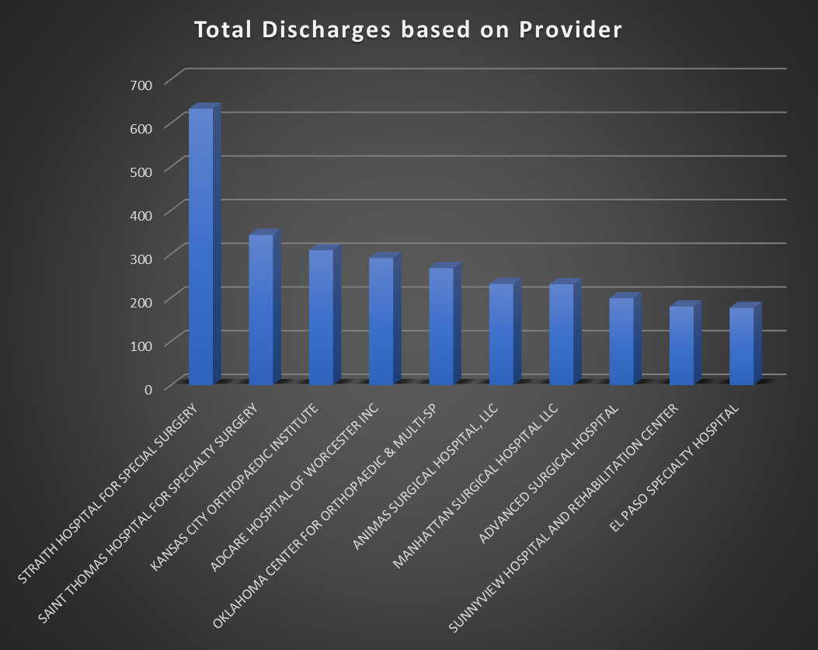
The total discharge is high in straith hospital for special surgery. The effective discharge rate with less readmission rate depends on the individual care provider, the patient, the relationship between providers, and the organizational and technical support for care providers.

Slide 7
Conclusion
The overall Medicare inpatient charge analysis gives insight about the which DRG is expensive overall, which providers charges the most. Further deep questions can be asked depending on the specific aims.

